Slide 1


BC2406
Aramco Corrosion Management
Lynn Chia Xiao Lian U2210598G
Seng Swee Chong U2211710D
Renee D’ Angela Raymond U2210393C
Sim YuYi U2210834B
Donovan Goh Jun Heng (U2220717H)
Nguyen Ngoc Tram Anh U2010920A

Slide 2
Table of contents
01
02
03
04
05
06
Introduction
Impact Evaluation
Our Approach
Company overview and problem statement
Oil spill dataset
Methodology
Linear Regression
CART
Conclusion

Slide 3
01
Introduction

Slide 4
Aramco
Nguyen Ngoc Tram Anh
Saudi Arabian
Oil company
World’s leading energy and chemical company
Largest oil reserve, largest daily oil production

Slide 5
Problem statement
Nguyen Ngoc Tram Anh
Internal corrosion
A $2.5 trillion global problem
Operational inefficiency
Substantial financial losses
Safety and Sustainability concerns
We intend to leverage data analytics and machine learning to help Aramco better predict potential pipeline corrosion and conduct predictive maintenance in a timely and efficient manner.

Slide 6
02
Impact Evaluation
Oil spill dataset
Notes:
To comprehend the impacts of oil spills we can explore our oil spill dataset.

Slide 7
Dataset introduction
Reliable
Record
Complexity
Nguyen Ngoc Tram Anh
A reliable public data source.
Contain records of oil pipeline leak and spill reported to P&HMSA since 2010.
48 Variables
2795 Data Points.

Slide 8
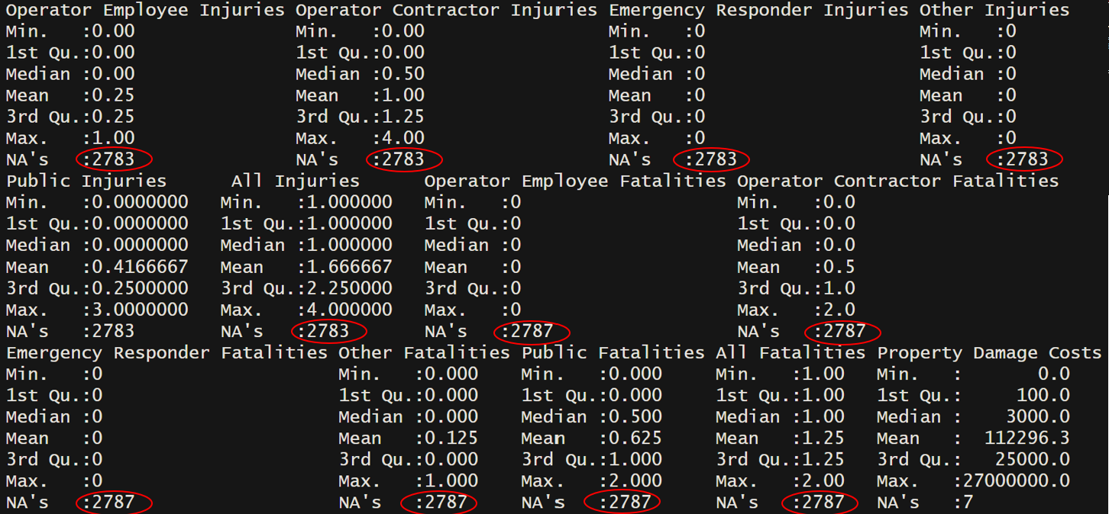
Data preparation
Nguyen Ngoc Tram Anh
Too many missing values (2783 NAs)
Need to remove those variables from our analysis
-> This will improve the overall quality of our dataset.

Slide 9
Creating new variables
Shutdown hours
Barrel loss (%)
Nguyen Ngoc Tram Anh
Difference between Shutdown Date/Time & Restart Date/Time
-> opportunity cost
Percentage of barrels that are undesirably released but are unable to be recovered.

Slide 10
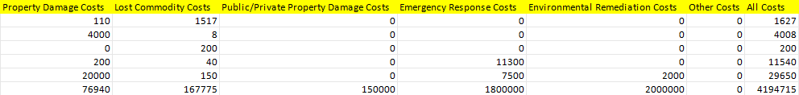
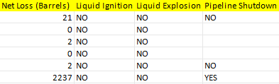
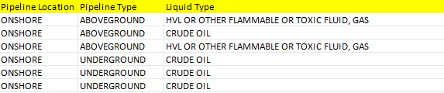
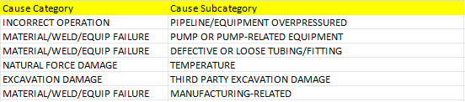
Assembling relevant variables
Nguyen Ngoc Tram Anh
Notes:
We filtered out variables that impact corrosion as shown on the screen here

Slide 11
Handling remaining NAs
Nguyen Ngoc Tram Anh
51 NAs left in cost variables (Highlights lack of data on costs)
Replace NA variables with 0
Preserve data integrity and does not affect total cost

Slide 12
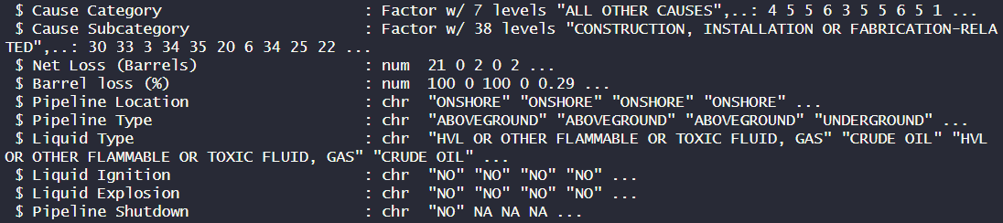
Changing variable types
Nguyen Ngoc Tram Anh
Supposedly categorical variables
Factorize variables
Export as “oilspill_cleaned.csv”

Slide 13
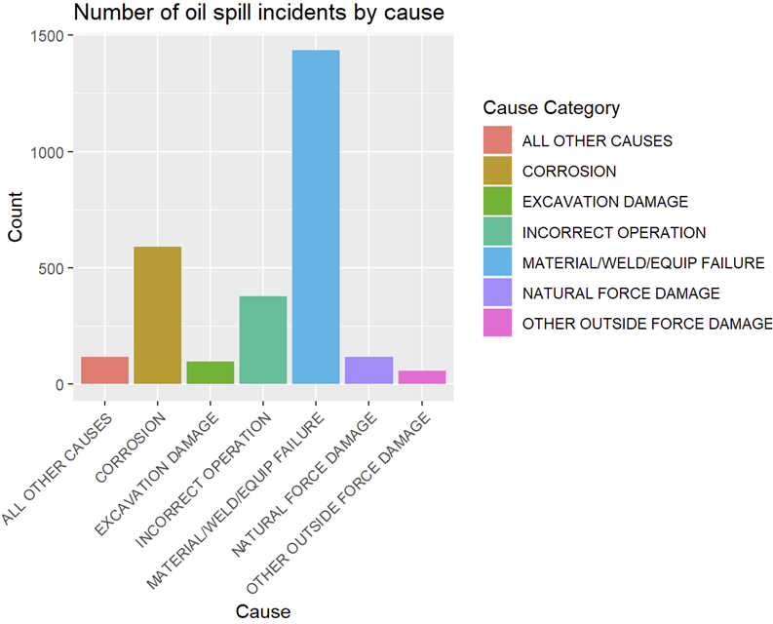
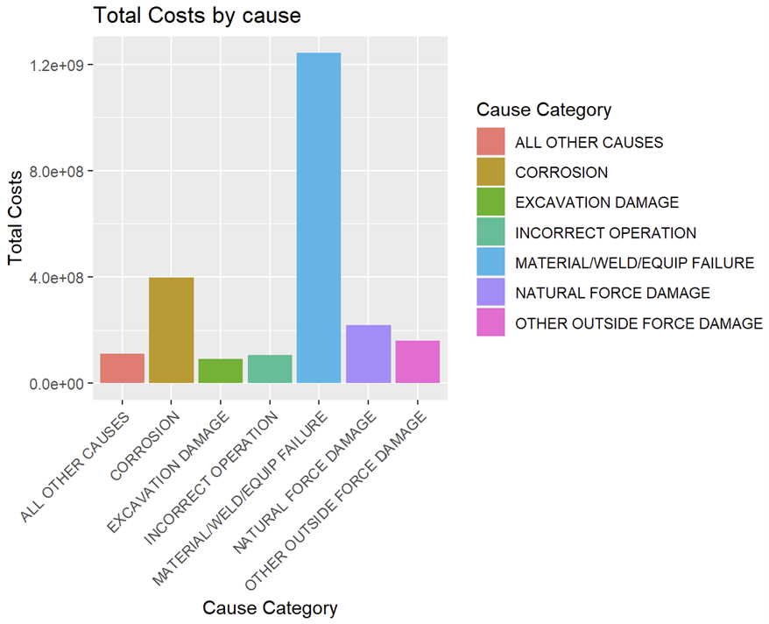
Exploratory analysis
Seng Swee Chong
Seismic surveys
Underground explosions
Corrosion is the 2nd most common cause of Oil Spill
Corrosion is the 2nd most costly
$667,780
lost / accident
137
barrel lost / accident
313 h
of shutdown / accident

Slide 14
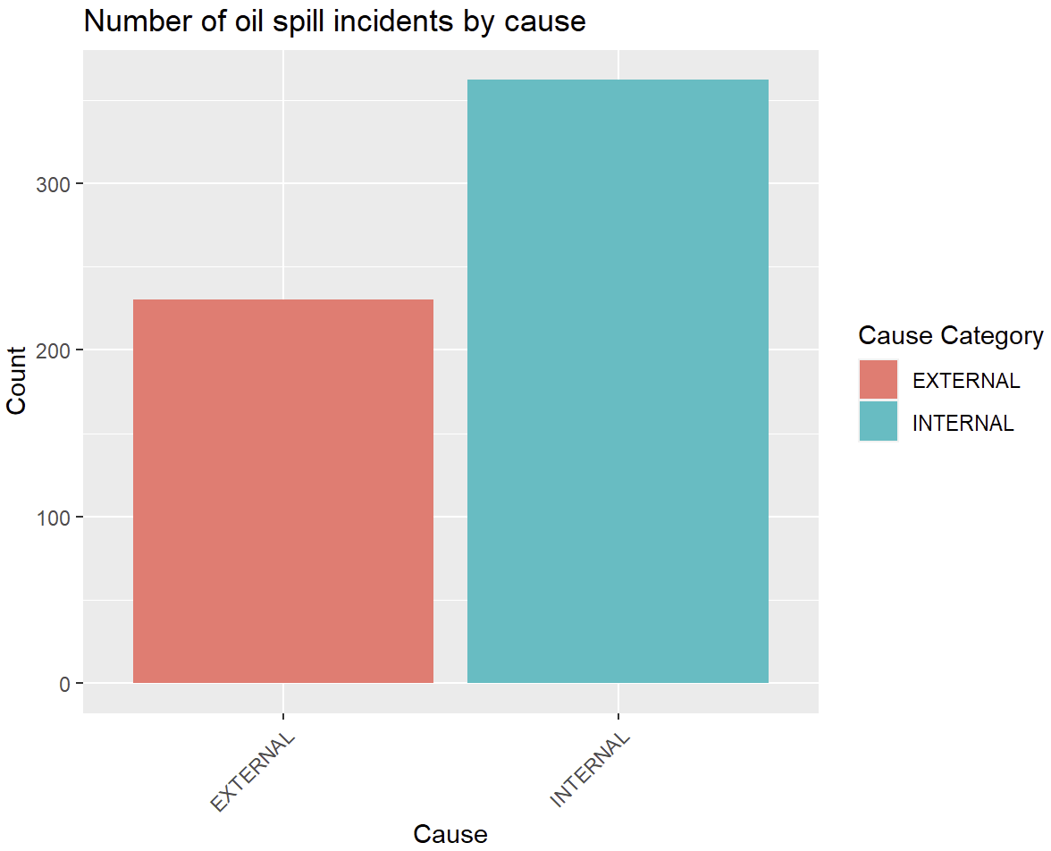
Exploratory analysis
Seng Swee Chong
Internal corrosion is more likely to cause oil spills

Slide 15
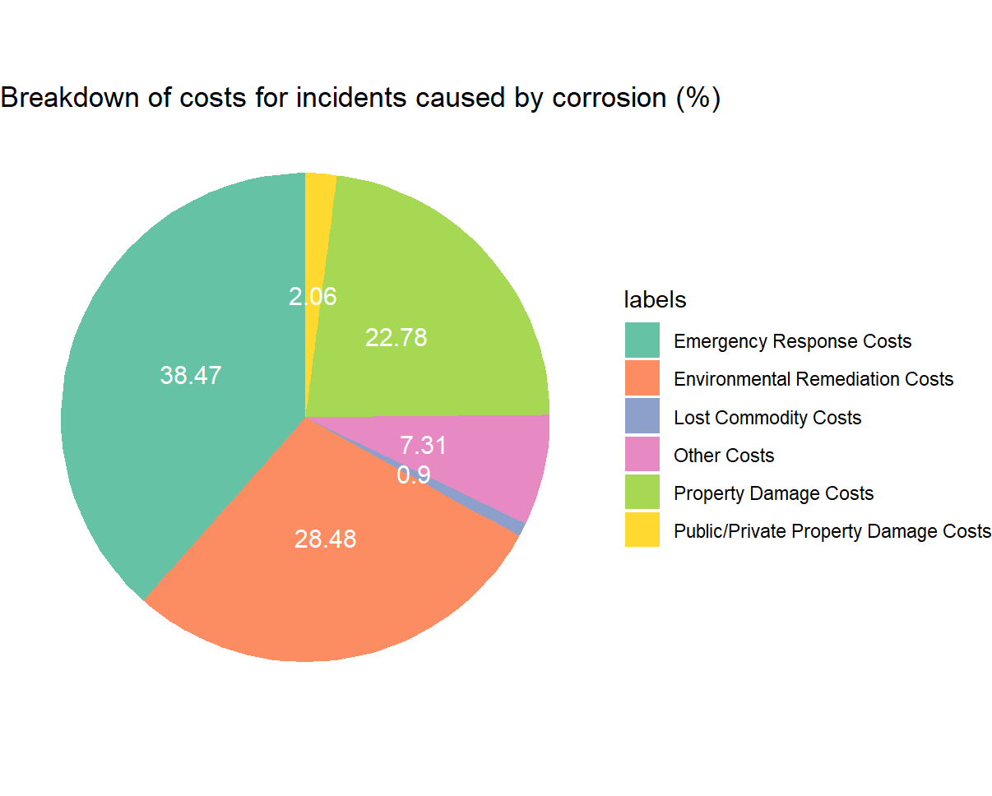
Exploratory analysis
Seng Swee Chong
38.47%
emergency response cost
24.48%
environmental remediation costs
22.78%
property damage costs

Slide 16
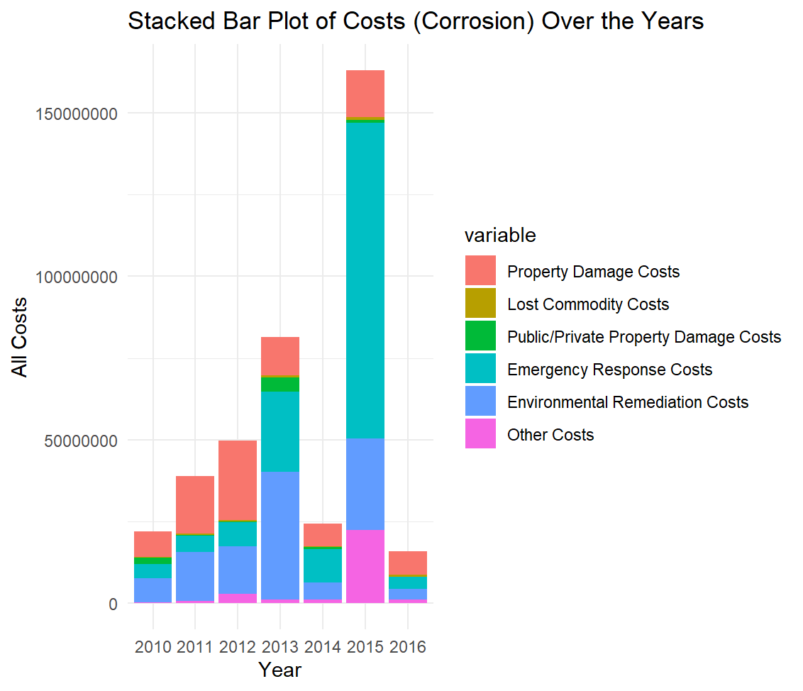
Exploratory analysis
Seng Swee Chong
Increasing trend of corrosion costs over the years (except 2014, 2016 & 2017)
Anomalies could be due to insufficient data
Cut-off at 2017

Slide 17
Shutdown prediction
Logistic regression
CART
Issues
Seng Swee Chong
Pipeline Type = Tank/Underground is significant
Pipeline type is the only significant factor
Low model accuracy (50-60%)
Insufficient predictive power of shutdown
Lack of data and predictor variables
All shutdown cases have onshore pipelines

Slide 18
03
Our Approach
Notes:
Thank you, Swee Chong. Machine learning techniques are powerful tools for the oil industry, which is why we’ve applied them in our approach to solving Aramco’s corrosion problem.

Slide 19
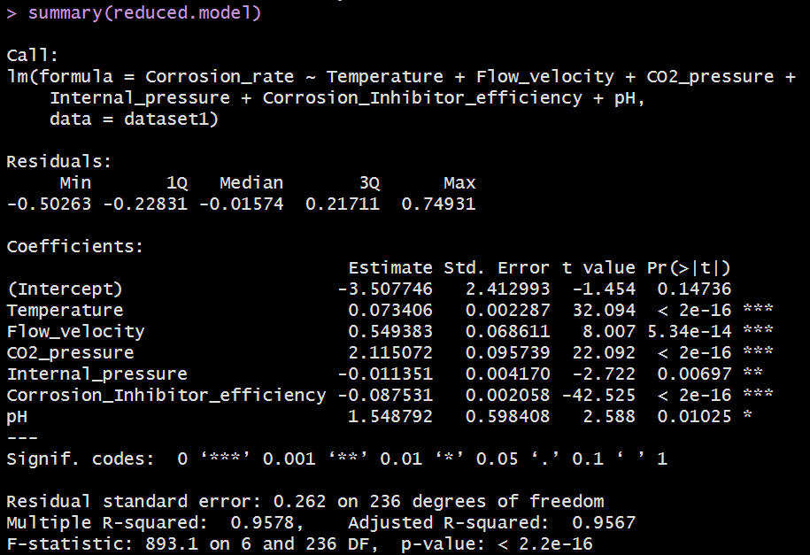
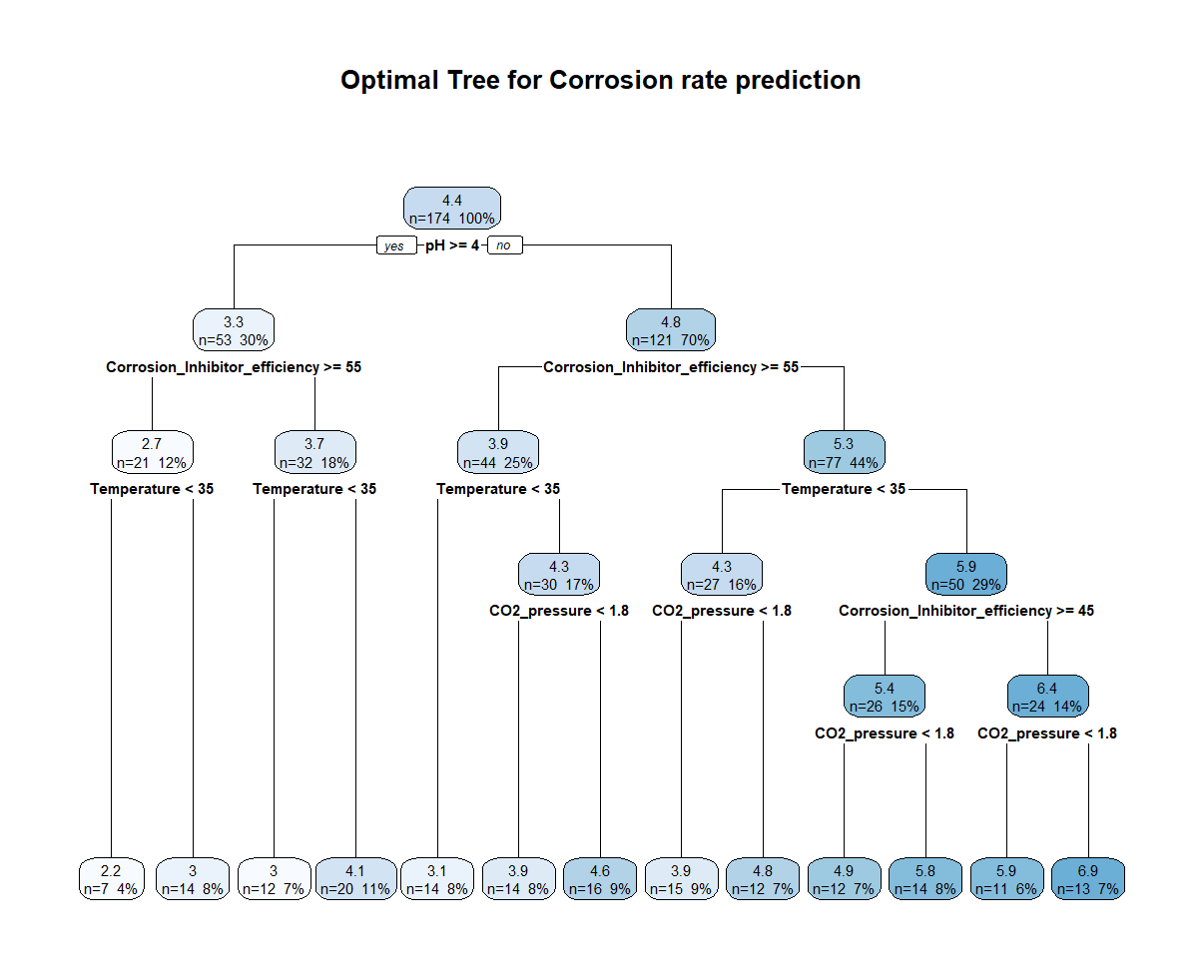
Prediction Models
Renee D’ Angela Raymond
Linear Regression
Classification And Regression Tree (CART)
Notes:
Our approach to addressing their challenge involves the development of two prediction models: a linear regression model and a classification and regression tree model.

Slide 20
About Our Corrosion Dataset
Renee D’ Angela Raymond
Simulated Data
Develop Predictive Models
Containing 8 variables, including corrosion rate and 7 crucial predictor variables
Observe the relationship between corrosion rate and the predictor variables, amd forecast corrosion rates in oil pipelines
Notes:
The corrosion dataset we used was obtained from Mendeley data, which is a reliable data source. The experimental and field measurements of internal corrosion rates are scarce, due to the cost and difficulty of inspection and monitoring techniques. As such, we’ll be using simulated data. The dataset contains 8 variables, including corrosion rate and 7 crucial predictor variables. Utilising this data to develop the two predictive models will allow us to observe the relationship between the corrosion rate and the predictor variables. As a result, we’ll be able to accurately forecast corrosion rates in oil pipelines and identify the contributing factors.

Slide 21
Variables
Renee D’ Angela Raymond
Corrosion Rate
Internal Pressure
Temperature
pH
CO2 Pressure
Shear Stress
Flow Velocity
Corrosion Inhibitor Efficiency
Notes:
These are the 8 variables included in the dataset.
The first variable is corrosion rate, which will act as our target Y variable. The 7 predictor variables are temperature, CO2 pressure, flow velocity of the fluid, the internal pressure of the transmitted fluid, pH, corrosion inhibitor efficiency against corrosion and shear stress, which reflects the influence of the physical properties, geometric characteristics, and velocity of the fluid on the motion characteristics of the fluid.

Slide 22
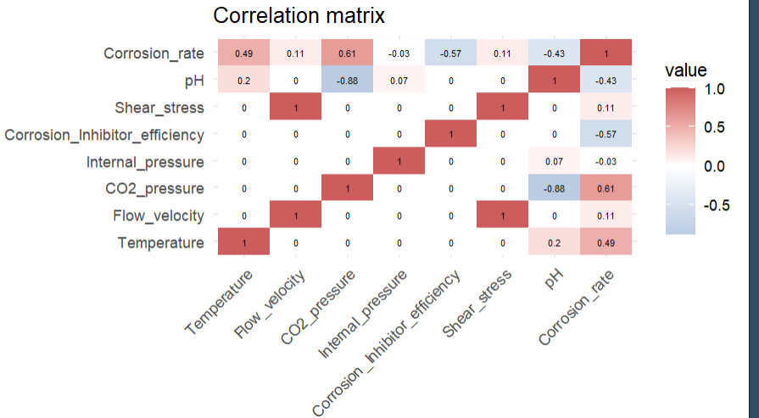
Correlation Matrix
Renee D’ Angela Raymond
Corrosion rate exhibits a strong positive correlation with CO2 pressure and temperature.
Corrosion rate shows a strong negative correlation with corrosion inhibitor efficiency and pH.
Shear stress and flow velocity have a perfect correlation of 1
Notes:
The relationship between the variables can be observed in this correlation matrix. There are 3 main observations from the matrix. Firstly, the corrosion rate exhibits a strong positive correlation with CO2 pressure and temperature.
Secondly, the corrosion rate shows a strong negative correlation with corrosion inhibitor efficiency and pH.
This means that when temperature and CO2 pressure in pipes increase, the rate of corrosion also increases. Conversely, when pH and Corrosion Inhibitor efficiency decrease, the rate of corrosion increases.
The third observation is that shear stress and flow velocity have a perfect correlation of 1. This suggests that shear stress and flow velocity can essentially be used interchangeably in a predictive model as they have the same predictive power.

Slide 23
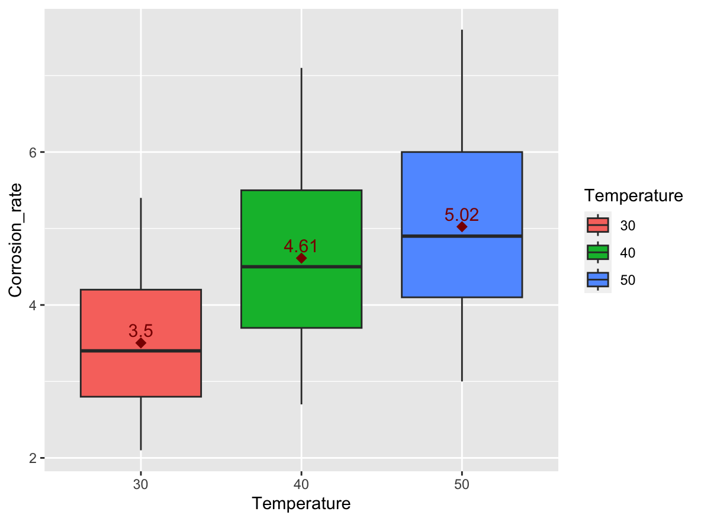
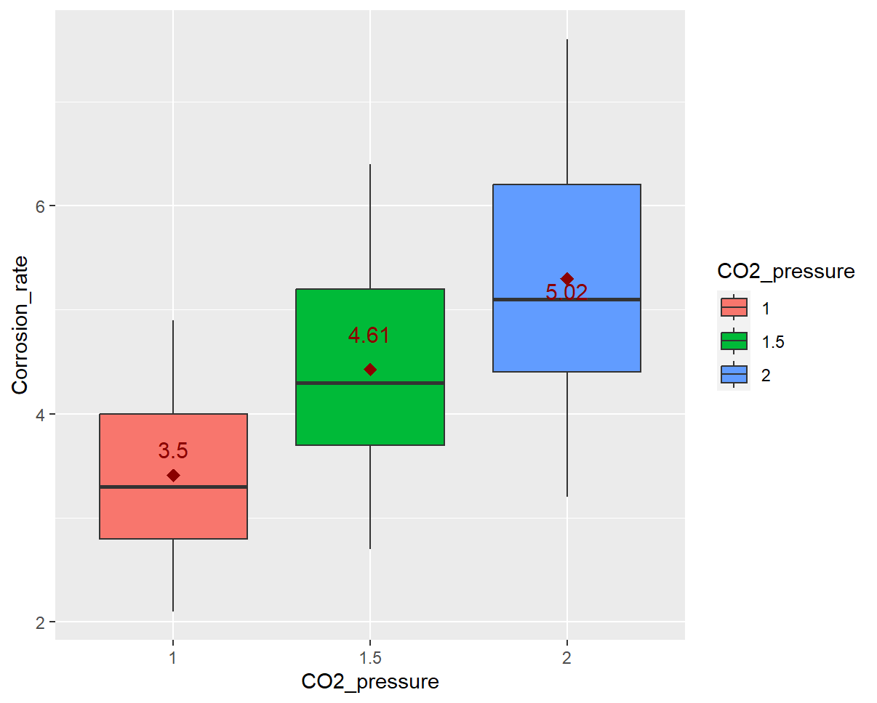
Positive Correlation
Renee D’ Angela Raymond
Corrosion rate against temperature
Corrosion rate against CO2 pressure
Notes:
To better understand the relationships between corrosion rate and some of the key variables, we've created box plots. As you can see, there is an upward trend in corrosion rates when temperature or CO2 pressure increases, reinforcing the positive correlations I mentioned earlier.

Slide 24
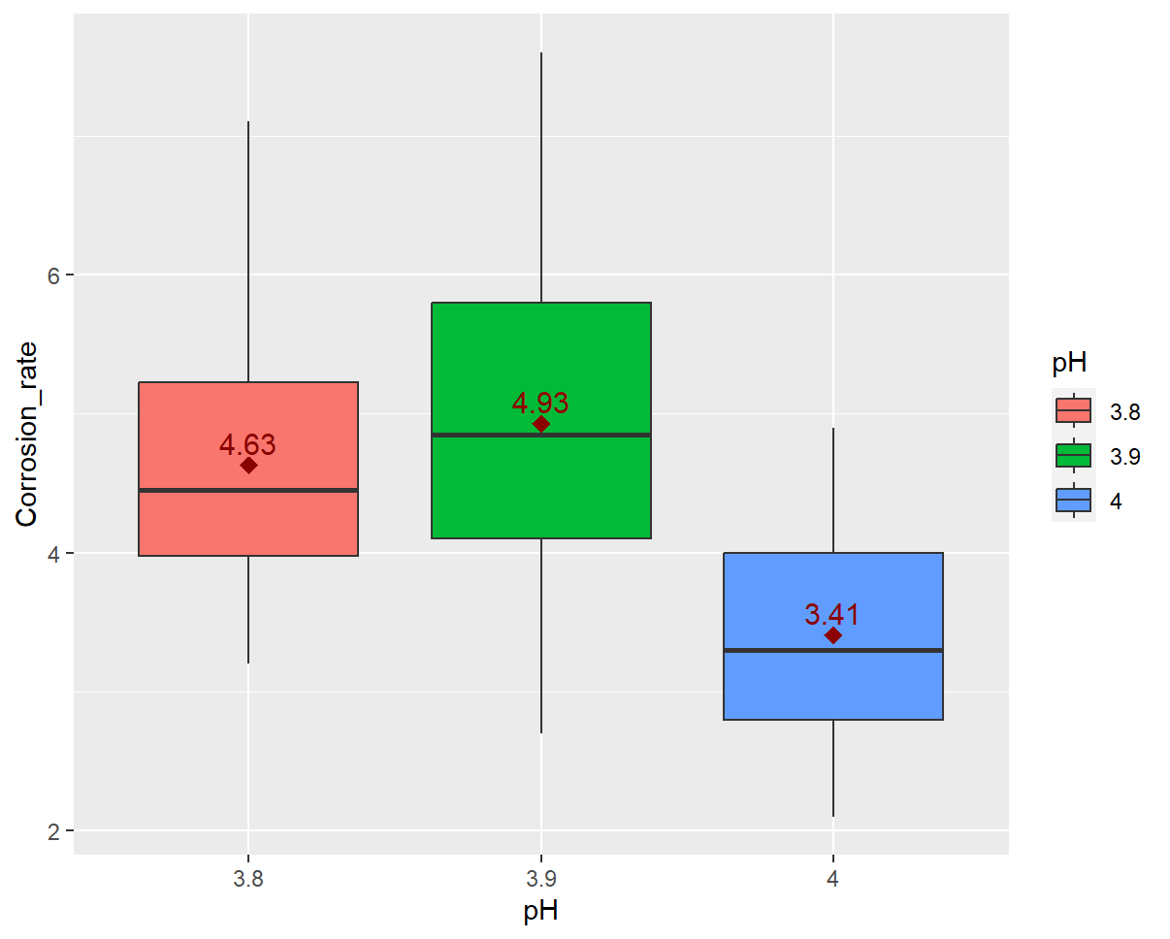
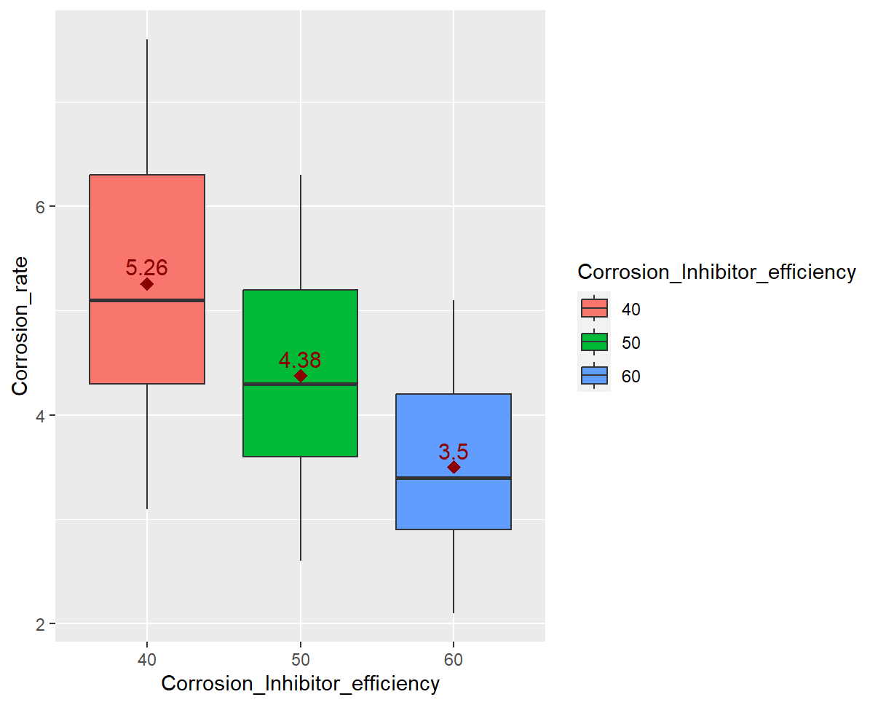
Negative Correlation
Renee D’ Angela Raymond
Corrosion rate against pH
Corrosion rate against corrosion inhibitor efficiency
Notes:
In contrast, when pH or corrosion inhibitor efficiency increases, corrosion rates exhibit a downward trend, illustrating negative correlations.
Since correlation does not imply causation, we still have to use our predictive models to pinpoint the significant factors affecting corrosion rate.
I will now pass my time on to Lynn, who will be discussing our linear regression model.

Slide 25
04
Linear regression

Slide 26
Linear Regression
Lynn Chia Xiao Lian
Preliminary model
Backward Elimination
Shear Stress is NA due to perfect correlation
Accuracy:
Complexity vs Noise
Multicollinearity
Model Accuracy
Vif> 10 : High Multicollinearity
None of our variables have VIF >10
Diagnostic plots and RMSE comparison
Notes:
Linear regression analysis is a statistical technique used to make predictions about one variable based on the value of another.
For linear regression, firstly, we came out with our preliminary model. One of the variable, Shear stress returned “ NA” results which could be due to perfect correlation with “flow velocity” This can also be seen from our correlation matrix.
A model with too many predictors is likely to overfit the training data, capturing not just the underlying signal but also the random noise inherent in the data. However, having too few predictors may fail to capture all the relevant variability in the data, leading to underfitting and potentially less accurate predictions. Therefore to derive a model that balances complexity with predictive power, we utilised backward elimination.
Backward elimination begins with a full model that includes all the potential predictors. In each step,the least significant predictor is removed.
By eliminating irrelevant or less important predictors, this reduced model can help reduce the potential for overfitting and makes it easier for us to interpret the relationship between predictors and the response variable. Therefore Shear stress was removed from our model through backward elimination.
Then we went on to check for multicollinearity:
Multicollinearity is not ideal as it means that it would be difficult for us to tell apart the individual effects of each variable on corrosion rate.
VIF more than 10 should be removed from our linear regression model but none of our variables have VIF >10.
Then we went on to assess our model’s accuracy with diagnostic plots and RMSE comparison

Slide 27
Final model
Lynn Chia Xiao Lian
Dependent variable (Y) : Corrosion Rate
Target variables (X): Temperature, Flow velocity, CO2 pressure, Internal pressure, Corrosion inhibitor efficiency, pH
Notes:
Dependent variable is corrosion rate and x variables are other variable other than shear stress (As it was removed during backward elimination stage)
Our linear regression model is multiple linear regression model as there are two or more factors/variables affecting the the y variable.
Based on our final model, CO2 pressure and pH are the two most significant factors affecting corrosion rate which can be seen from the coefficient in our linear model.
Every increase in CO2 pressure will result in 2.12 increase in the rate of corrosion and every increase in pH will result in 1.55 increase in rate of corrosion.

Slide 28
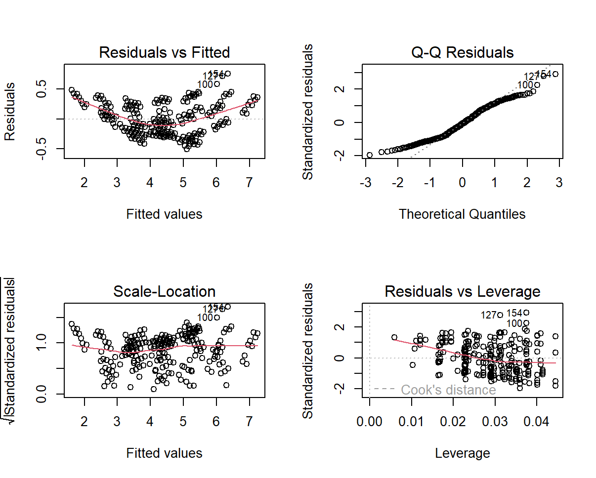
Diagnostic Plot
Lynn Chia Xiao Lian
Residuals vs Fitted
Q-Q Residuals
Slight Curvature possibly indicating a non-linear pattern in data.
Might have slight deviations from normality with potential outlier
Scale-Location
Residuals vs Leverage
Residuals are spread equally along range of predictors
No significant influential outlier
Notes:
Diagnostic plots are a critical part of data analysis in statistics and machine learning, as they provide visual insight into the relationship between variables, the fit of a model, if the predictions violate any of the 3 assumptions of linear regression (like homoscedasticity(constant variance of errors), normality of errors, and independence of errors) and the potential presence of outliers or anomalies.
Our diagnostic plot indicates that there are no major problems in the data that need to be rectified.

Slide 29
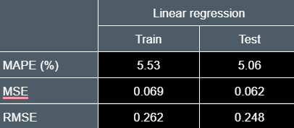
Model Accuracy
Lynn Chia Xiao Lian
Set.seed(2004)
Our corrosion dataset divided into Trainset (70%) and Testset (30%)
MAPE:Mean absolute percentage error
MSE: Mean square error
RMSE:Root mean square error
Notes:
Then we went on to access accuracy of model through these three matrix of error. MAPE MSE AND RMSE
All three metrics are used to measure the accuracy of predictions made by a model in statistics and machine learning.
The consistently low average errors for both train and test set suggest that the model is proficient at making reasonably accurate predictions of the "Corrosion_rate" based on the provided predictor variables and there was no overfitting of data.
Mean Absolute Error (MAE):
MAE gives a linear score, meaning all individual differences are weighted equally in the average.
MAE provides a straightforward arithmetic average of the errors. MAE is robust to outliers, while MSE and RMSE are more sensitive to them
Mean Squared Error (MSE):
MSE gives a quadratic scoring of the errors. Because the errors are squared before they are averaged, MSE gives a relatively high weight to large errors. This means the MSE is more useful when large errors are particularly undesirable.
MSE penalizes larger errors more severely because it squares the errors before averaging, which can reveal whether a model has a particular problem with large deviations.
Root Mean Squared Error (RMSE):
It is calculated by taking the square root of MSE.
RMSE is similar to MSE but the square root helps to bring the units back to the original units of the output variable and can be more interpretable as it is on the same scale as the error.
RMSE, by taking the square root of MSE, reduces the scale of the error to be on the same scale as the data, which can be useful for interpretation and comparison with MAE.

Slide 30
05
CART
Notes:
CART (Classification And Regression Tree) is a supervised Machine Learning predictive model which creates a decision tree by splitting the dataset multiple times according to certain cutoff values of the X-variables, which will be splitting criteria.
Regression trees: used when the target variable is continuous.
Since our target variable is continuous, our tree model will be a regression tree

Slide 31
CART
Donovan Goh
Maximal Tree
Optimal Tree
12 intermediate nodes
14 terminal nodes
11 intermediate nodes
13 terminal nodes
Variable importance
Model Accuracy
Significant Impact on the predictive power the model
MAPE, MSE & RMSE comparison
Notes:
In our cart model , we will be talking about maximal tree, optimal tree, variable importance and model accuracy

Slide 32
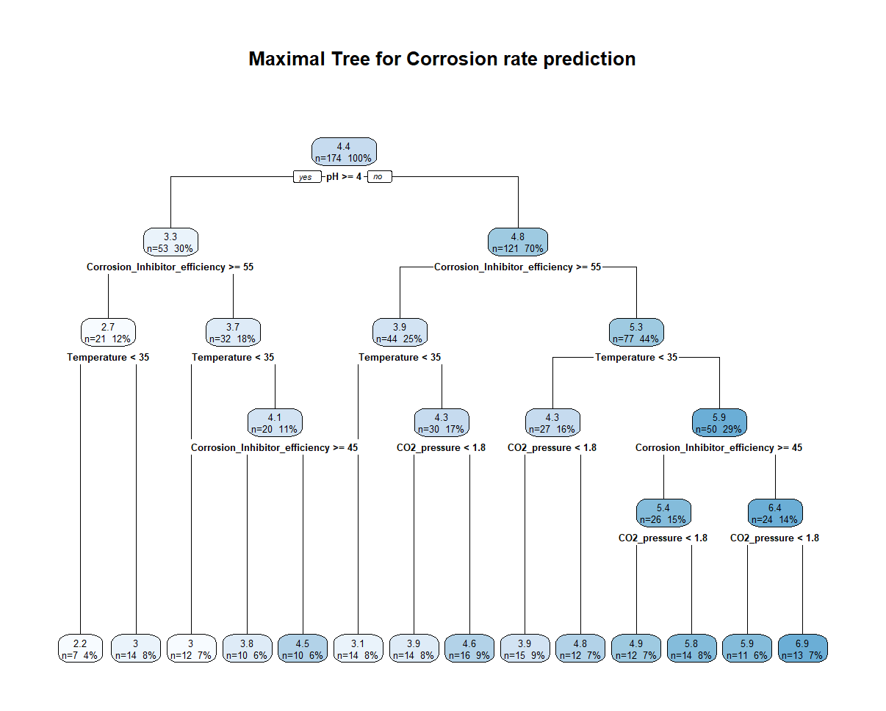
Maximal tree
Donovan Goh
Notes:
This is our maximal tree using cp = 0 to grow the tree to maximum.
The maximal tree has in total 27 nodes, including 1 root node, 12 intermediate nodes and 14 terminal nodes.

Slide 33
Optimal tree
Donovan Goh
Notes:
The original tree is usually not the optimal tree, so we perform pruning to make sure the optimal tree is derived as shown in new optimal tree has 25 nodes in total, with 1 root node, 11 intermediate nodes and 13 terminal nodes.
From the optimal tree we can note that pH above 4, Corrosion inhibitor above 55,
Temperature < 35, co2 pressure below 1.8 will lead to lower rates of corrosion compared to those below.

Slide 34
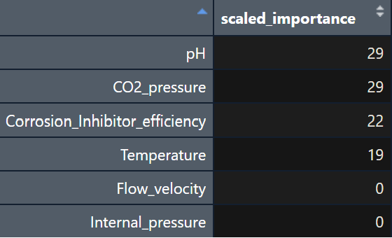
Variable Importance
Donovan Goh
Notes:
Out of the 6 x variables used, only 4 variables are considered to have a significant impact on the predictive power of the model, thus largely influencing the predicted corrosion rate. As seen above, pH and CO2 pressure is the most important variables of importance of 29%, followed by corrosion inhibitor efficiency 22% and temperature 19%. The 4 variables are also splitting criteria for our tree. The remaining 2 variables, Flow velocity and Internal pressure did not contribute to the predictive power of this model.

Slide 35
Model Accuracy
Donovan Goh
Set.seed(2004)
Our corrosion dataset divided into Trainset (70%) and Testset (30%)
 | CART
 | Train | Test
MAPE (%) | 6.120 | 7.350
MSE | 0.101 | 0.133
RMSE | 0.317 | 0.365
MAPE:Mean absolute percentage error
MSE: Mean square error
RMSE:Root mean square error
Notes:
As mentioned by Lynn, the cart model accuracy is based on mape, mse and rmse.
The percentage error of predicted values for train set ranges from 0% to 20.5882% which is stable. MAPE of 6.12%, MSE of 0.101 and RMSE of 0.317 suggest that the model demonstrates relatively low errors on average.
Similarly, The percentage error of predicted values for test set ranges from 0% to 17.1429, . MAPE of 7.35%, MSE of 0.133 and RMSE of 0.365.
Consistently low average errors suggest that the model is proficient at making reasonably accurate predictions of the "Corrosion_rate" based on the provided predictor variables and there was no overfitting of data.

Slide 36
Comparison between Linear Regression and CART
Donovan Goh
 | Linear regression |  | CART
 | Train | Test | Train | Test
MAPE (%) | 5.53 | 5.06 | 6.120 | 7.350
MSE | 0.069 | 0.062 | 0.101 | 0.133
RMSE | 0.262 | 0.248 | 0.317 | 0.365
Notes:
After assessing the performance of our models, it becomes evident that the linear regression model consistently outperforms the CART model across various metrics, boasting lower (MAPE) (MSE), and (RMSE).
This advantageous outcome can be primarily attributed to the notably strong linear relationships that exist between our predictor variables and the target variables. Moreover, it's worth noting that linear regression holds a distinct advantage in its simplicity and ease of comprehension, making it a valuable tool in our analysis and explanation.

Slide 37
Donovan Goh
Linear Regression or CART?
Notes:
Linear regression !
it might not be sufficient as it assumes linear relationships between variables. As a result, we can use a CART model to supplement our regression.
This can be seen in the discrepancy of pH in our cart and linear regression
In linear regression, every increase in pH results in a 1.55 increase in the rate of corrosion. However, our CART models show that pH > 4 results in a lower corrosion rate which ties in with our research.
As pH increases, the corrosion rate decreases. At higher pH, iron carbonate precipitates as a dense, protective surface film which helps to reduce corrosion rates.
From our analysis of industry experts and understanding the limitations of the regression model, the CART model is more appropriate for pH.
This emphasises the importance of complementing both models and the use of industry specific knowledge.

Slide 38
06
Conclusion

Slide 39


Business Recommendations
Sim Yuyi
Increase pH
Lower CO2 Pressure
Adding alkaline substances through the addition of chemicals or corrosion inhibitors, using an automatic pH monitoring system
Use of CO2 scavengers or treating the oil through gas- liquid separators (Direct Air Removal Technology)
Notes:
From our models, we can see that the 2 most important variables which affect corrosion the most are the pH of the oil, and the CO2 pressure in the oil.
Since the pH from the data ranges from 3.8 to 4, this indicates that currently, oil passing through the pipelines are acidic. This can cause acidic corrosion to the pipelines, and is also reflected by the levels of corrosion when the oil is more acidic compared to when it is not. So, one way to help Aramco reduce corrosion in its pipelines is to increase the pH. We can do so by adding alkaline substances to the oil, through the use of alkaline chemicals, or corrosion inhibitors which release alkaline compounds. This can be further enhanced by using an automatic pH monitoring system, which ensures that no human interaction or attention is needed if the liquid gets too acidic after a period of time.
Moving on, the second way Aramco can curb corrosion is by lowering CO2 pressure. This actually ties into our first point of increasing the pH in the oil, as CO2 causes corrosion by making the oil acidic, since CO2 is an acidic gas. In order to lower the CO2 pressure, we have to lower the amount of CO2 in the oil, and one way of doing so is through the use of CO2 scavengers, or treating the oil with gas-liquid separator. This will remove CO2 from the oil and lower the CO2 content, in turn lowering CO2 pressure.
These 2 business recommendations are made through our analysis and from the insights we gained from our model.

Slide 40
Limitations and further Considerations
Sim Yuyi
Use of Simulated Data
Narrow Data Ranges
Inability to evaluate impacts not in Dataset
Insufficient Data
Geographical Differences
Notes:
However, it is important to take into mind the limitations of our analysis, and we cannot overlook some of the flaws we have in our data.
The first, is that the dataset we used is simulated data. Simulated data can and will differ from actual data, as the environment and circumstances in which the data is collected will change and affect the data, such as the pH or the CO2 levels.
Next, is narrow data ranges. Some of the variables in the data have very little variation, such as pH only having observations with 3.8, 3.9, and 4.0. The Temperature variable similarly had limited observations, only up to 120 degrees celsius. From our research, we found that higher pH levels of 5 or 6 can actually further reduce corrosion by a large extent, however, we are unable to make this conclusion from our dataset.
Another limitation of our project is that our models have little predictive value for when pipeline shutdowns will occur. To a business, having processes or infrastructure such as pipelines shut down and stop working is the worst thing that can happen. When pipelines shutdown, that means that no work can be done, and it will have disastrous consequences on profits and/or revenue.
My team was also limited by the time period in which the data was collected. From the dates logged in each individual observation, we know that the data was collected from 2010 to 2017. The last observation was made during Jan 2017, and in January 2017 alone, only 2 observations were logged. This could be misleading, as can be seen from our graphs, where there were close to no incidents in 2017. Additionally, this also means that the data was effectively accumulated starting from 2010, so some of the data is older than 10 years ago. Such data may become obsolete and irrelevant. Had we used more recent data, I would be confident that our analysis and insights would be more targeted and effective.
The last drawback of our project is the geographical difference in which the data was accumulated. This dataset came from the United States, but Aramco’s oil fields are located in Saudi Arabia. This could lead to some differences in environment, such as the material used for pipelines, and this will lead to different results as there are many factors which can change and affect corrosion.

Slide 41
Thank you!

